Slide 1

Data’s Metamorphosis
{
Algorithms for detecting change points in data
Chris Natoli, Cody Buntain, and Miroslav Živković
OSDC PIRE Fellowship 2014

Slide 2
Change points
What are they?

Slide 3


Slide 4


Change Point

Slide 5

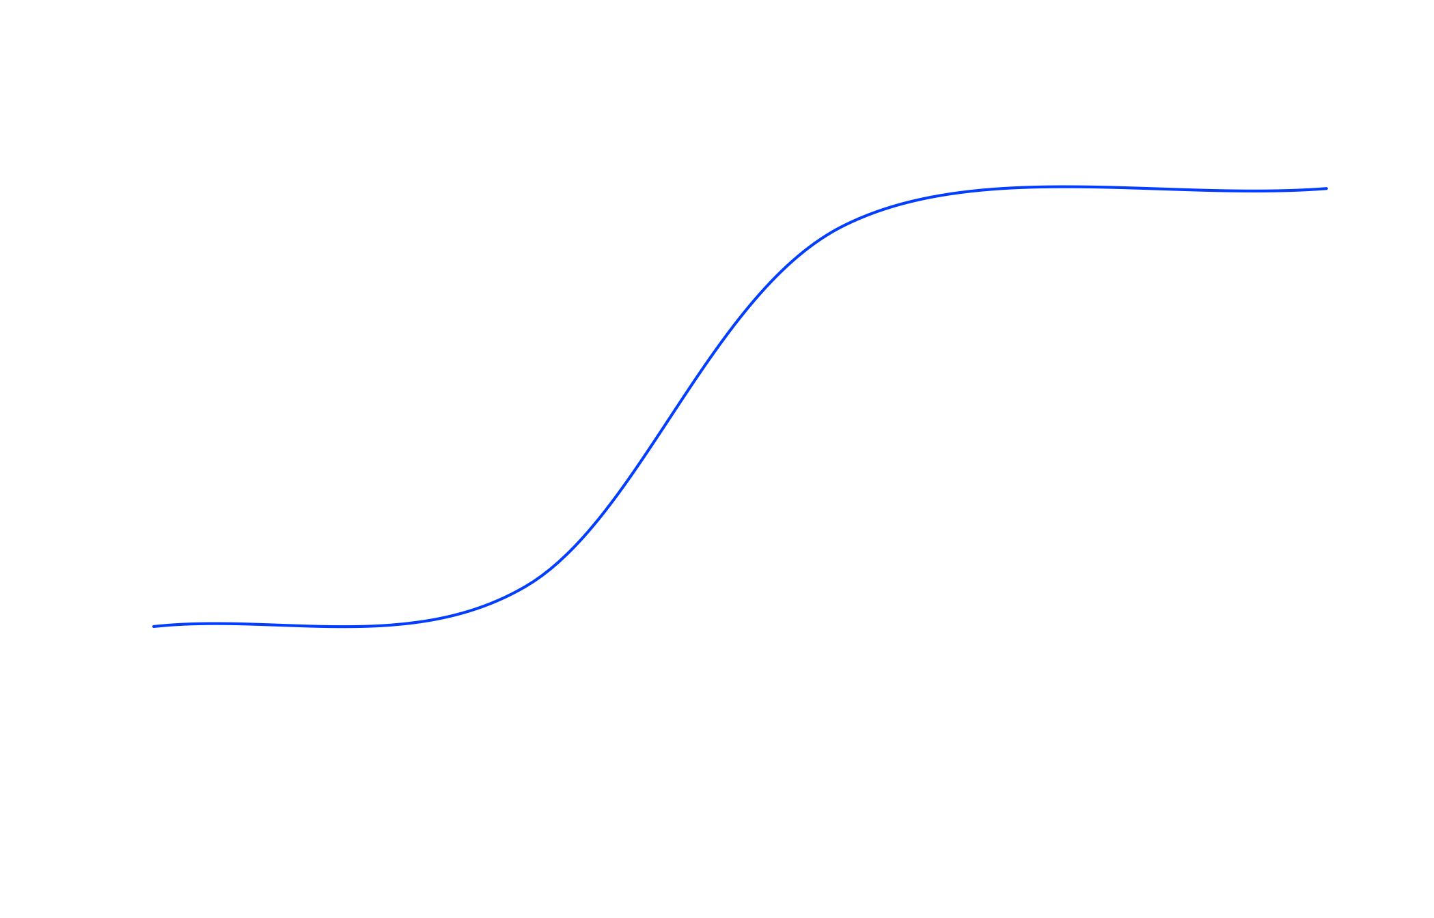
{

Slide 6



Slide 7

Other Applications
Economics

Slide 8
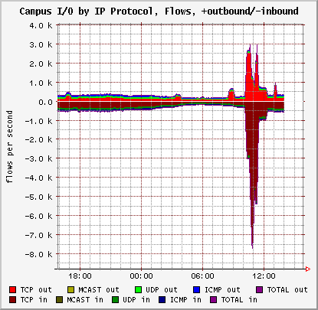
Other Applications
Cyber security

Slide 9
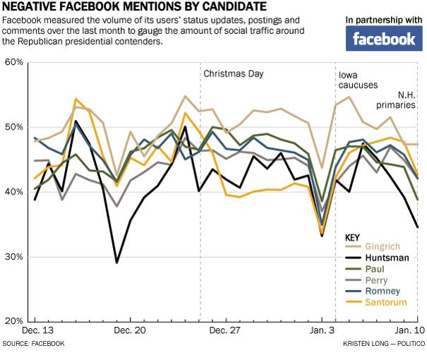
Other Applications
Sentiment in Social Media

Slide 10
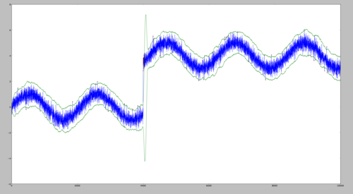
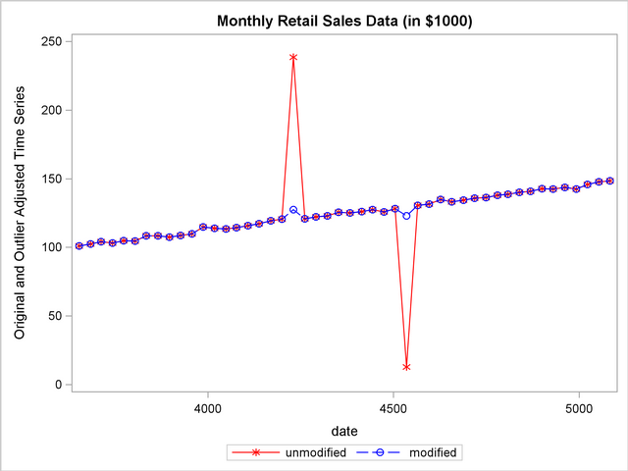
Versus Outlier Detection
Outliers
Change Point
Duration!

Slide 11
Algorithms
How do you find change points?

Slide 12
Many algorithmic methods
Specifically focused on multi-dimensional methods
Offline Approaches
Likelihood-ratio tests
Cumulative sum of squares
Online Approaches
Support vector machines
Density ratios
}
Parametric,
Covariance-based
}
Non-parametric

Slide 13
Likelihood-Ratio Test
We assume the data follows a vARIMA model process

Slide 14
Likelihood-Ratio Test
Null model:
No change point in the data
Alternative model:
For some potential change point at time h
P. Galeano and D. Peña, “Covariance changes detection in multivariate time series,” J. Stat. Plan. Inference, vol. 137, no. 1, pp. 194–211, Jan. 2007.

Slide 15
Likelihood-Ratio Test
Find h_{max} that maximizes LRT_{stat}
If LRT_{max} exceeds some critical value at h_{max}, a change point occurs at h_{max}
If change point is found, split data at h and re-run algorithm on 1≤j<h and h<j≤n

Slide 16
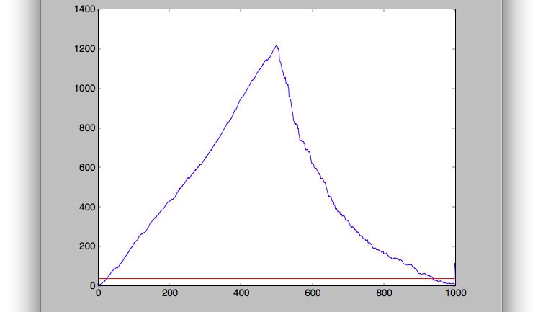
Likelihood-Ratio Test
h_{max}
LRT Statistic
{
{
Time

Slide 17
CUSUM
{
Building the test statistic
Test statistic =
P. Galeano and D. Peña, “Covariance changes detection in multivariate time series,” J. Stat. Plan. Inference, vol. 137, no. 1, pp. 194–211, Jan. 2007.

Slide 18
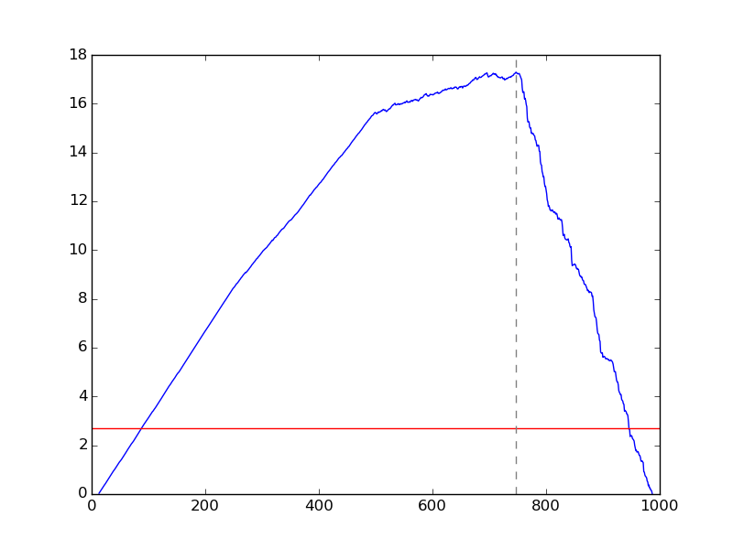
CUSUM
{
Finding a single change point
Cusum statistic for a time series with three changepoints.

Slide 19
CUSUM
{
Finding a single change point
which is a known distribution, so we can compute critical values.

Slide 20
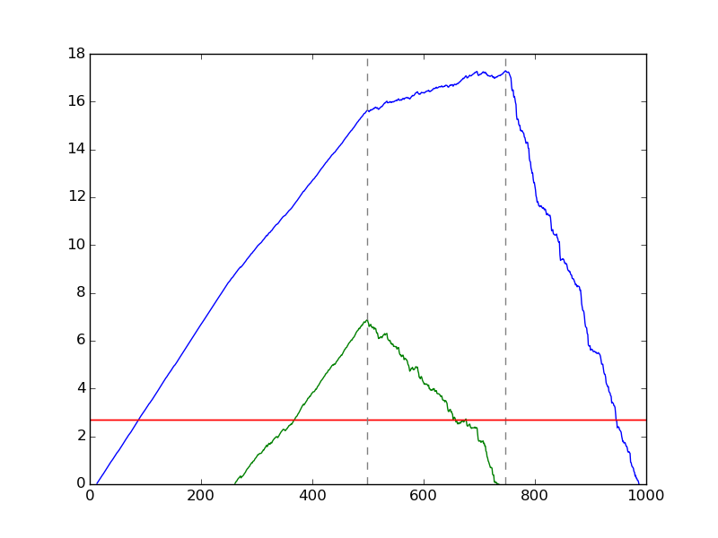
CUSUM
{
Finding more change points
Cusum statistic for a time series with three changepoints.

Slide 21
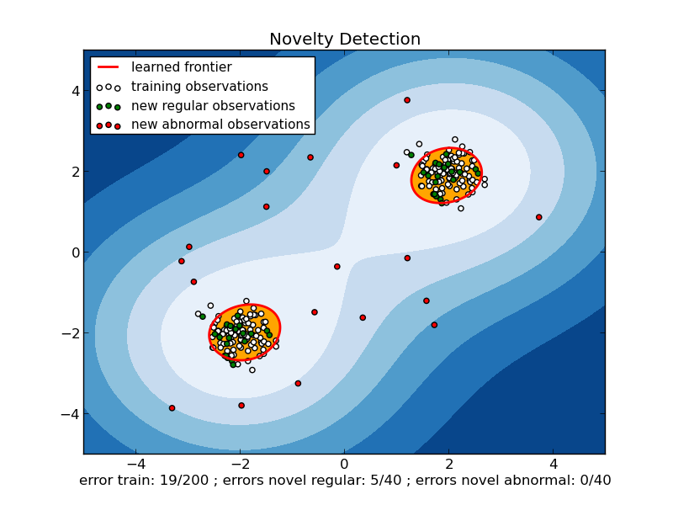
SVM Change Detection
Uses kernelized one-class SVMs (KCD)
Learned decision planes describe and differentiate between data regimes
F. Desobry, M. Davy, and C. Doncarli, “An online kernel change detection algorithm,” Signal Process. IEEE Trans., vol. 53, no. 8, pp. 2961–2974, Aug. 2005.

Slide 22
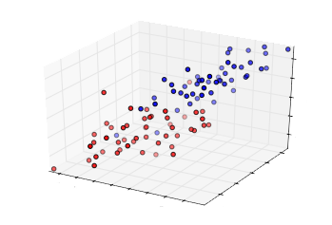
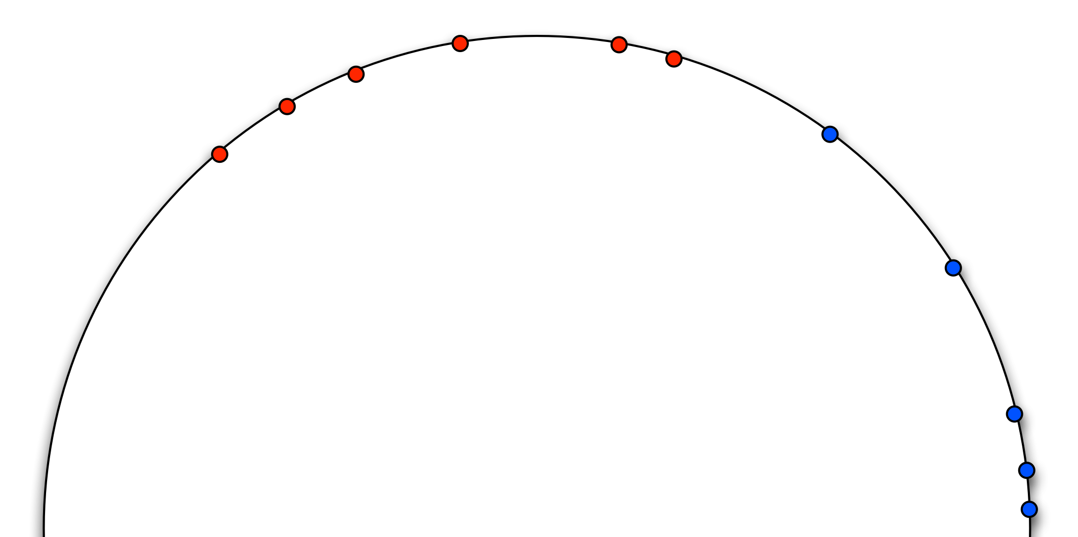
SVM Change Detection
Kernel
Given some time point h, look at the previous m points and the next m points
Learn one-class SVM weights for these past and future sets

Slide 23
SVM Change Detection
c_{p}
Past
c_{f}
Future

Slide 24
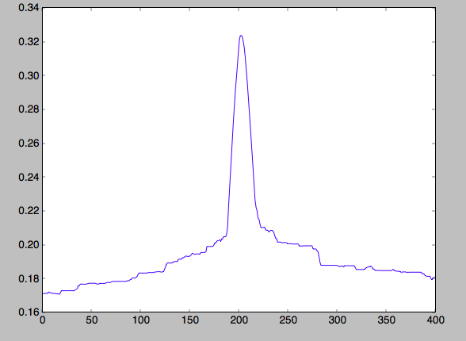
SVM Change Detection
Slide 2m window over data
If kcd_{stat} exceeds some threshold at h, classify h as a change point

Slide 25
Density Ratios
{
Moving from data points to subsequences
Suppose time series y(t) ∈ R³ and denote its ith component by y_{i}(t) ∈ R.
Define the subsequence:
Kawahara, Yoshinobu and Masashi Sugiyama. “Sequential changepoint detection based on direct density ratio estimation.” Statistical Analysis and Data Mining 5.2 (2012): 114-127.

Slide 26
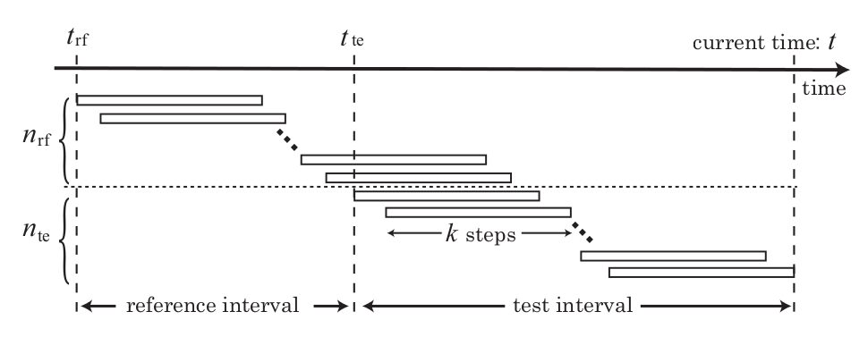
Density Ratios
{
Moving from data points to subsequences
Sliding window of subsequences
(Reference interval has PDF p_{rf} and test interval has PDF p_{te})
Kawahara, Yoshinobu and Masashi Sugiyama. “Sequential changepoint detection based on direct density ratio estimation.” Statistical Analysis and Data Mining 5.2 (2012): 114-127.

Slide 27
Density Ratios
{
Hypothesis tests
Kawahara, Yoshinobu and Masashi Sugiyama. “Sequential changepoint detection based on direct density ratio estimation.” Statistical Analysis and Data Mining 5.2 (2012): 114-127.

Slide 28
Density Ratios
{
Directly estimating the density ratio
Kawahara, Yoshinobu and Masashi Sugiyama. “Sequential changepoint detection based on direct density ratio estimation.” Statistical Analysis and Data Mining 5.2 (2012): 114-127.

Slide 29
Density Ratios
{
Directly estimating the density ratio
Kawahara, Yoshinobu and Masashi Sugiyama. “Sequential changepoint detection based on direct density ratio estimation.” Statistical Analysis and Data Mining 5.2 (2012): 114-127.

Slide 30
Algorithm Performance
How do they compare?

Slide 31

Performance Comparison
Compared accuracy across:
Type of change point (covariance or mean)
Data dimensionality
Autoregressive parameters

Slide 32
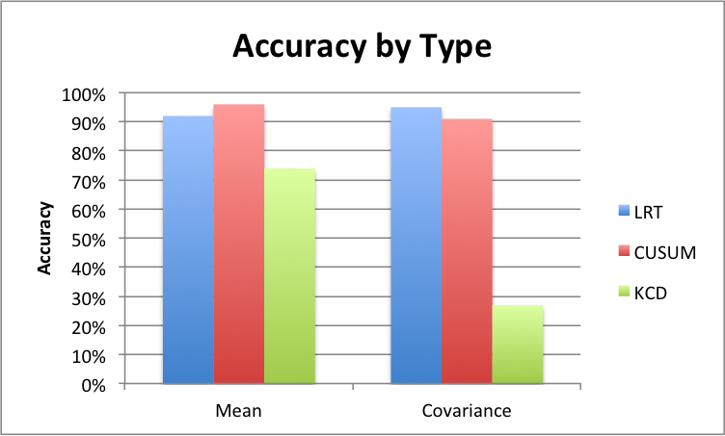
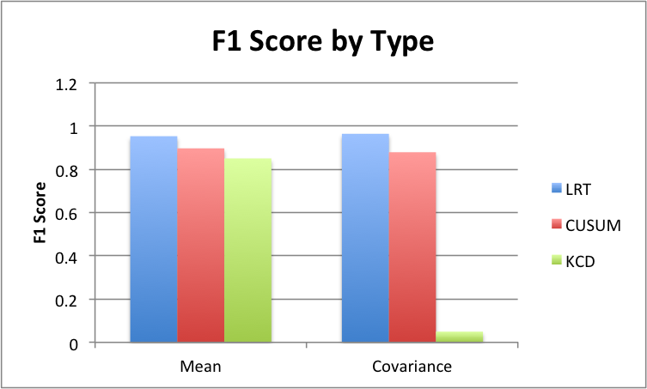
Change Point Type
Change in mean of data or in covariance of data

Slide 33
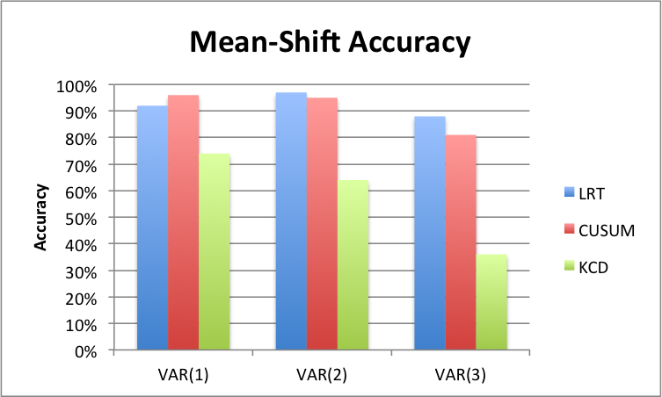
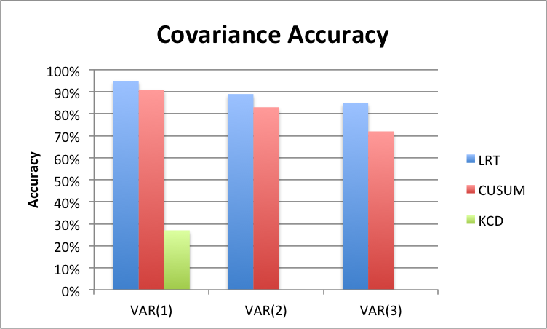
Autoregressive Models
VAR(p) with p=[1,3]

Slide 34
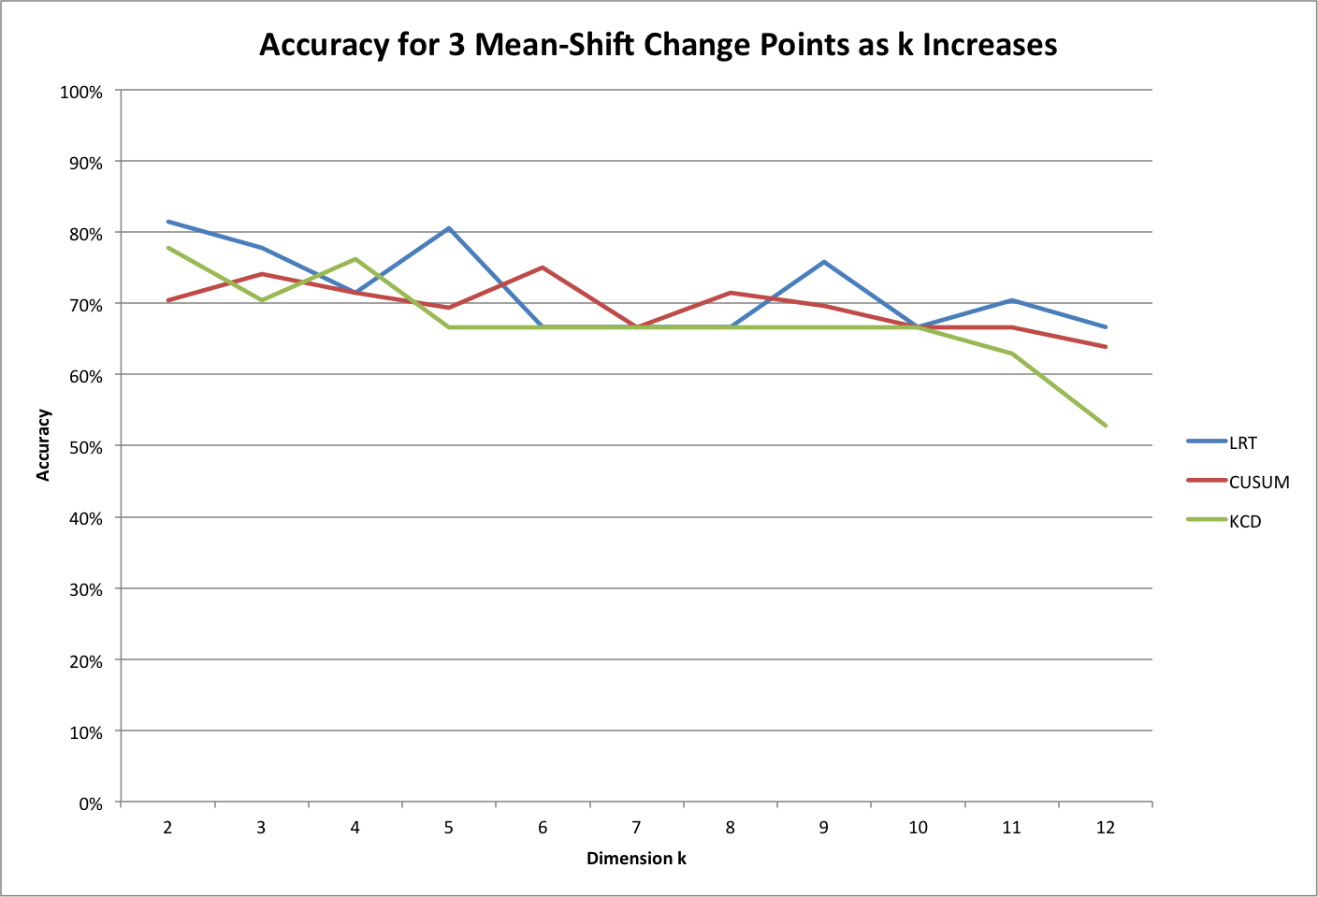
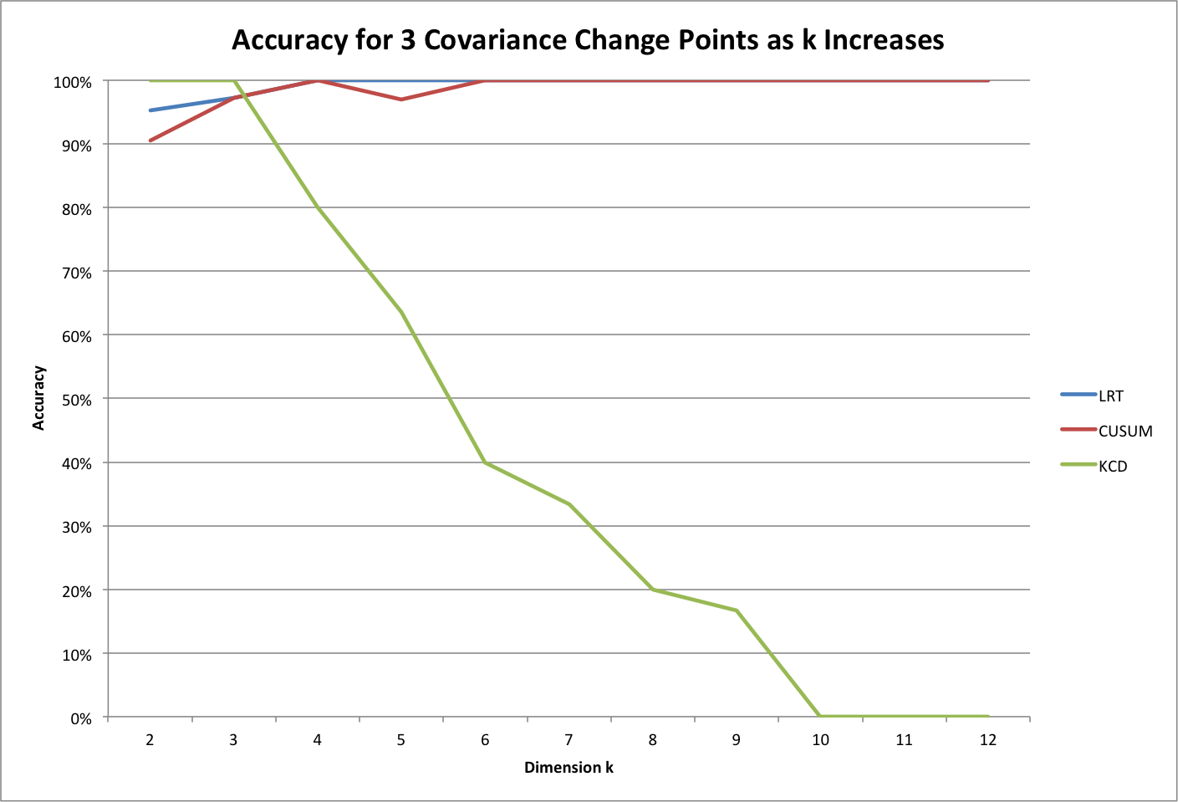
Dimensionality
Covariance
Mean-Shift
k=[2,12], change point count = 3

Slide 35
Real Data Applications
What can we learn?

Slide 36

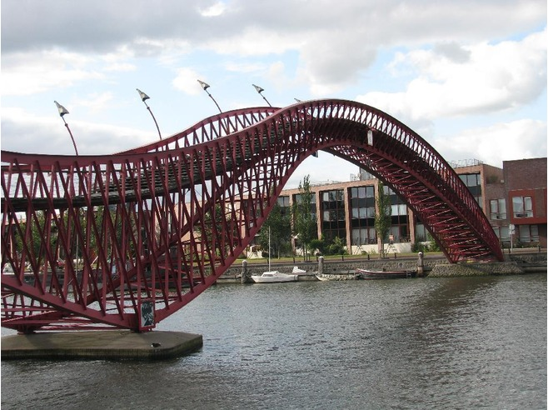
Applications to Real Data

Slide 37
Bitcoin Market Data

Slide 38
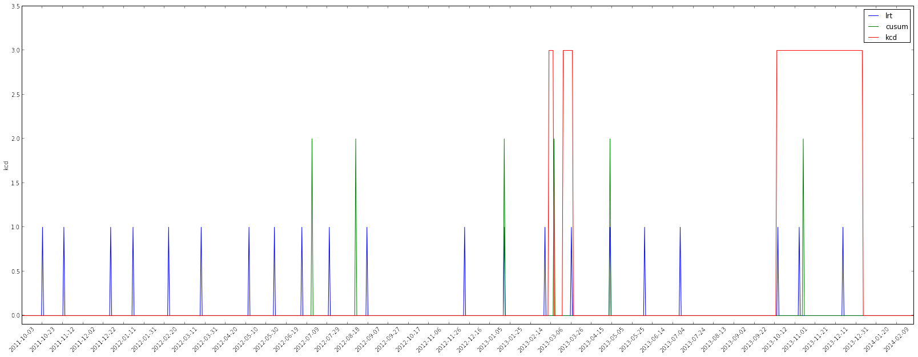
Bitcoin Change Points

Slide 39
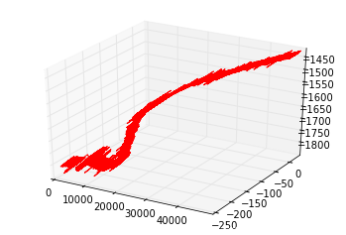
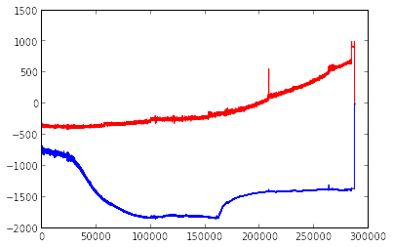
Bridge Sensor Data
Bivariate sensor data provided by a structural testing lab in Delft
Sensors record structural properties during stress testing

Slide 40
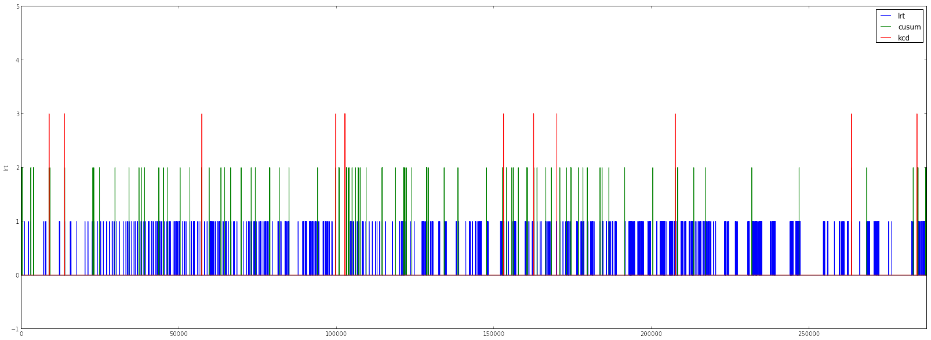
Bridge Change Points
Notes:
Worth mentioning some things about scale here

Slide 41
?

